Slide 1
Building Your Cash Confidence
Paychecks You Deserve
Three Money Tools for Instant Income
Notes:
How do you build your business so strong that you make a bigger impact on this world
What does prosper and grow mean for you? What is important to you?
Welcome to beauty business essentials
It is filled with three videos that will support your business prosper and grow

Slide 2
Bankrupt To BOOMING
BOOMING
Notes:
It took me til 2005 opening up that I was able to see what is possible to have systems in place to have a profitable business
I am so committed to solving money issues in this industry.

Slide 3
What We Will Be Covering
Arm yourself with simple strategies that drive growth and prosperity
Declaring the paycheck you deserve
Become confident in your financial forecasting
Launch Instant Income tools for revenue growth
Notes:
Over the next 3 videos

Slide 4
“Having money isn’t everything, not having it is.”
- Kanye West
Notes:
When I was 5 years old
24 years old
In my 20 I built businesses
30’s I reinvested but started to save
32 years old I started to build a cash reserve
We spend in our business like we do our personal

Slide 5
74% Of Businesses In The United States Are NOT Profitable!

Slide 6
Why My Business Was Not Profitable
Prices were too low
Productivity was too low
Commissions were too high
Expenses were through the roof
Retail was an afterthought
Business and spa owners don’t plan for profits…we hope for them!
Notes:
Lets jump into more prosperity and more growth for you and your business.
Make sure you have your workbooks and tools printed or downloaded

Slide 7
Paychecks You Deserve
Notes:
I have too many owners not taking a paycheck that they deserve
That makes no sense to me.
80% of small businesses fail in the first 5 years
40% of all businesses are owned by women!
1 in 12 close every year
20% don’t pay themselves the salary they deserve
88% of businesses are making $100k or less

Slide 8
In This Video We Will Be Covering
Arm yourself with simple strategies that drive growth and prosperity
Declaring the paycheck you deserve
Notes:
Over the next 3 videos

Slide 9
“Goal is a dream
with a deadline.”
- Napoleon Hill
Notes:
Whats your goal for this year? Post it so you can see it daily –goal is a dream with a deadline Napoleon hill
The future belongs to those who believe in the beauty of their dreams – Eleanor Roosevelt
“Good business leaders create a vision, articulate the vision,
passionately own the vision,
and relentlessly drive it to completion.” -Jack Welch

Slide 10
In Just Six Weeks…
Notes:
We will be focusing on what you can accomplish in 6 weeks- about the time your clients will be coming back for their color appointment
You will see results faster and keeps you on track- its rapid but so effective
This six weeks we will be focusing on your growth for your business and your paycheck

Slide 11
Six Week Growth Plan
Area Of Focus/Goal | 2 Weeks | 4 Weeks | 6 Weeks
Notes:
6 WEEK PLAN STRATEGY
Put your areas of focus and goals in column 1
In the 2 week window columns outline the milestones you need to reach to obtain those goals or action steps you need to take to execute that project in the next 6 weeks
Include up to 2 milestones per box or 6 items every 2 weeks to keep focus and reduce overwhelm. Additional to-dos associated with each milestone are captured in weekly to-dos or more detailed project plans.

Slide 12
Two Places To Look For Growth
#2 Planning out your future business
#1 Tapping into your current business
Notes:
I want you to look around you. There is money everywhere

Slide 13
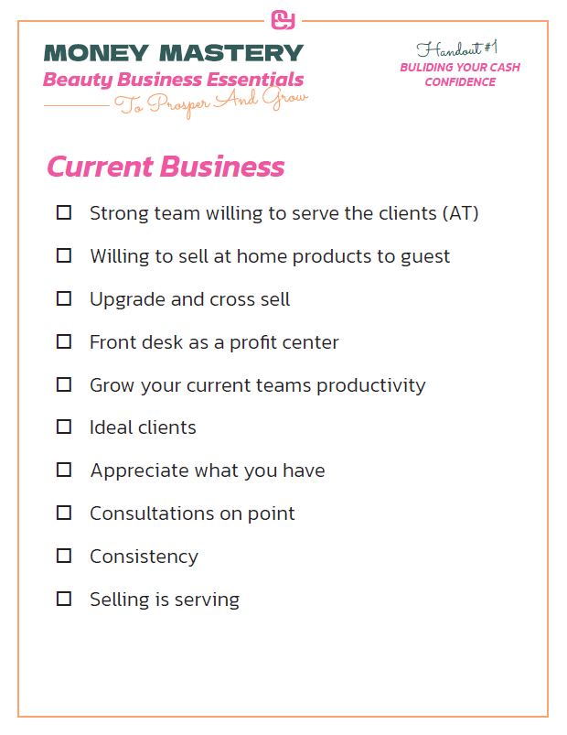
#1 Current Business
Notes:
Sometimes we need to take care of the business we have first before we go get new
Here is a list of all the places that we can look for missed opportunities

Slide 14
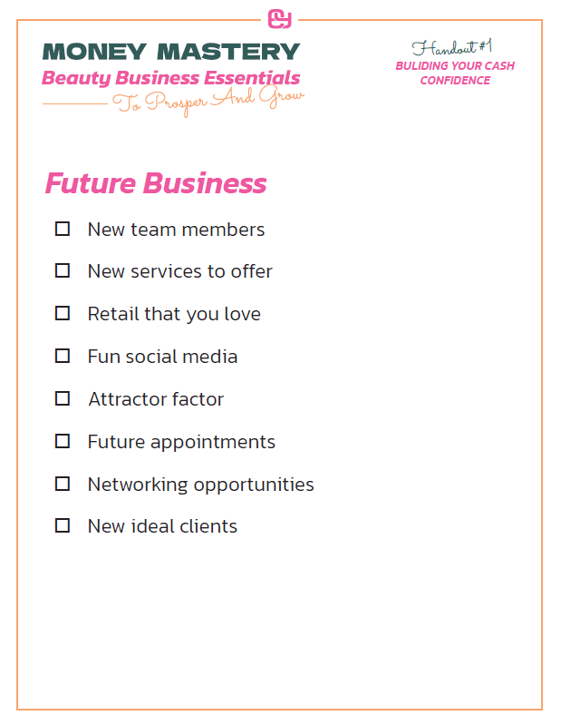
#2 Future Business
Notes:
And there are times we need to also look at new business
What is the vision for your business? What do you want it to look like and feel like?

Slide 15
Just The Next 6 Weeks
Align your to do list from your plan daily
Set aside 5 minutes each week to plan

Slide 16
Your Next Paycheck
What's that number?
How will you get there?
Who are you not charging the right prices?
Notes:
In order to increase your check– you gotta upgrade relationship, support, structure, habit and capabilities
What do you need to learn?
When we are making less and charging less – we are bored- complexity boredom and conflict--

Slide 17
STRATEGIZING YOUR NEXT PAYCHECK
How can you improve your relationships with your team, clients, and networks? Meet one on one with team Networking events in your community | How can you improve your support structure? Better handbooks and training Hire an assistant
How can you improve your work habits? Lessen distractions Plan out your day | How can you grow new skills? Social media CFO/CEO mindset
Notes:
Tool one– blank one of this
Slide with this info below
Strategizing your next paycheck
How can you improve your relationships with your team, clients, and networks?
Meet one on one with team
Networking events in your community
Improve your work habits
Lessen distractions
Plan out your day
How can you improve your support structure
Better handbooks and training
Hire an assistant
New skills to grow
Social media
CFO/CEO mindset

Slide 18
Let's Take Some Action Now
What is the vision of your business?
Where can you tap into growth in your current business?
Where are there opportunities in growing your future business?
What strategy will you put in place to grow your paycheck?

Slide 19
“The future depends on what you do today.”
- Mahama Gandhi
Notes:
The future belongs to those who believe in the beauty of their dreams – Eleanor Roosevelt
“Good business leaders create a vision, articulate the vision,
passionately own the vision,
and relentlessly drive it to completion.” -Jack Welch

Slide 20
Building Your Cash Confidence
Notes:
$299 value
How do you build your business so strong that you make a bigger impact on this world
What does prosper and grow mean for you? What is important to you?

Slide 21
Wealth Is Not What’s In Your Bank Account. Wealth Is A State Of Mind.
Notes:
Self worth= net worth

Slide 22
We Will Be Covering
Money mindset
Become confident in your financial forecasting
Notes:
Over the next 3 videos

Slide 23
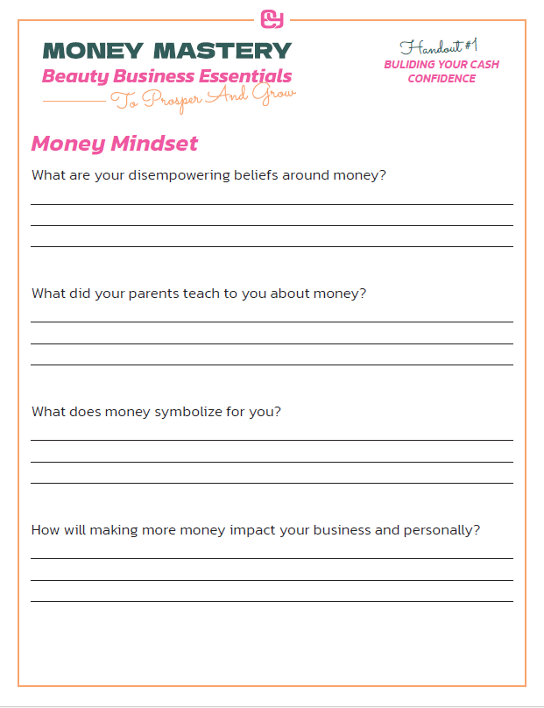
Money Mindset
Notes:
I want to first take a look at when I say look at your finances…why do you get sick to your stomach, or maybe your palms are sweating.
We all have unique financial challenges..lets first take a look at what you are currently struggling with when its coming to your money.
Are you ready to change it? Want more power over your money monster? Lets do this think.
Are you ready for a new story or keep the old one? What is your money story? How will you rewrite it to be empowering

Slide 24
How Cash Confident Are You Feeling Right Now?
Least Confident Most Confident
1 2 3 4 5 6 7 8 9 10
Notes:
No matter where you are…its all ok!

Slide 25
Confidence In Your Cash
Money in the bank
On top of your finances monthly
Work inside of a budget – where “B” isn’t a bad word
AT are double base price
Retail at least 25% to service
Chairs are at least 70% productive
Happy team
Thriving paychecks
Up to date on all taxes

Slide 26
Least Cash Confidence
Unexplained expenses
Last minute cancellations
Attrition of team members
Waste of supplies (BB)
Prices are not covering cost
Culture is default
Working too many hours
Limited support for owner
Productivity is too low

Slide 27
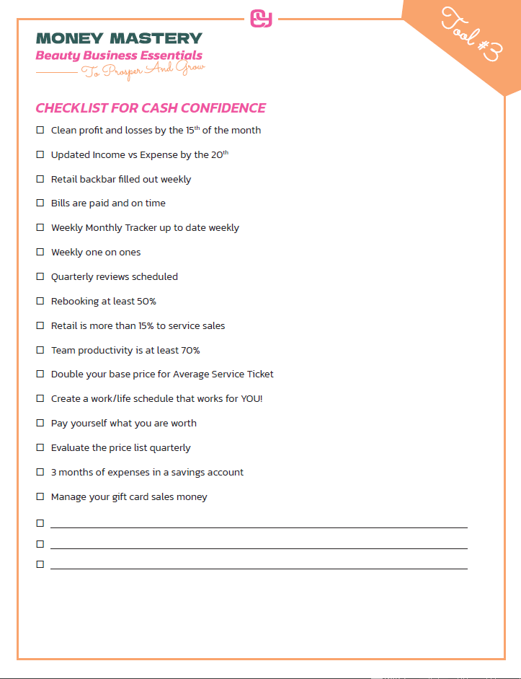
Checklist For Cash Confidence
Notes:
Tool #2 checklist for managing your money

Slide 28
What Do You Need To Do?
What actions will you take to move into cash confidence?
How can you move things off your least cash confident list?

Slide 29
Three Money Tools For Instant Income
Notes:
$299 value
How do you build your business so strong that you make a bigger impact on this world
What does prosper and grow mean for you? What is important to you?

Slide 30
Your Money Loves Order

Slide 31
Today, We Will Be Covering…
Why “budgets” are not a bad word
Launch Instant Income tools for revenue growth
How to double your day
Be the solution
Notes:
Over the next 3 videos

Slide 32
Instant Income Now
“Budgets” isn’t a bad word after all
Average tickets
Consultations that serve vs. sell
Notes:
The clearer you get on your business plan then you get cash confidence and be your best self

Slide 33
#1 Budgets
Personal Budget
Business Budget
Notes:
Income vs expense tool
Trim the fat and keep the muscle
Budgets is not a bad word
We spend in business like we do in personal

Slide 34
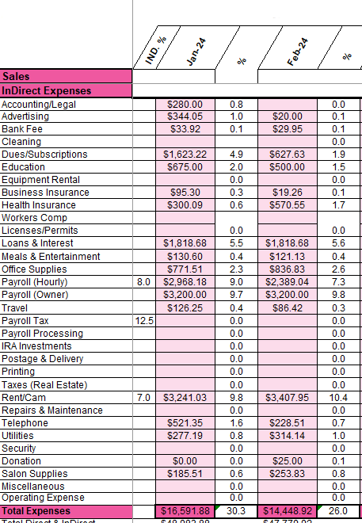
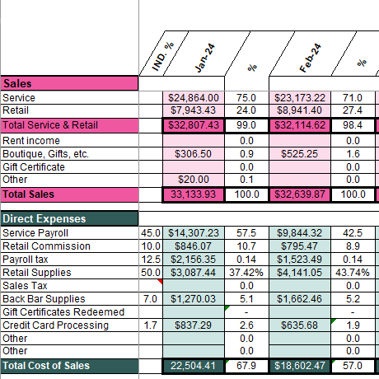
Where Does The Money Go?
Notes:
39096.29— is total for expenses vs 33133 in revenue
234576 is six months with payroll

Slide 35
Where Does The Money Go?
Notes:
Look at these expenses!

Slide 36
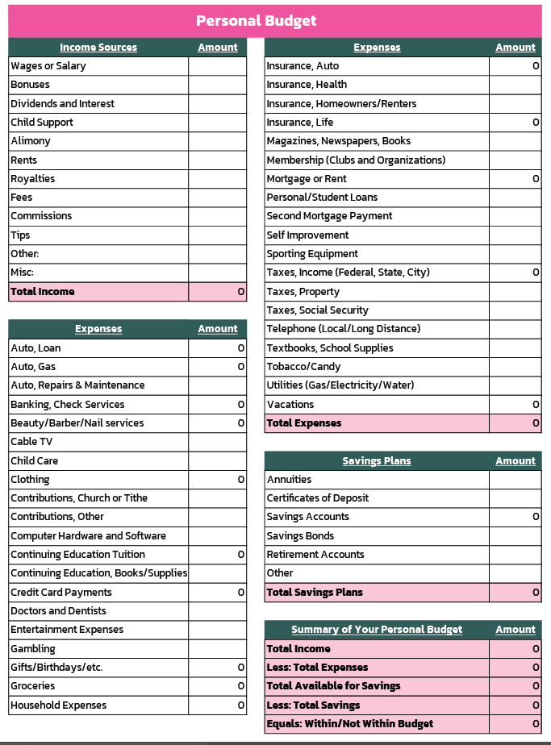
Where Does The Money Go?
Notes:
Lets look at your personal budget
Your 5 by 5

Slide 37
“Systems make you more resilient.”
− Marina Darlow

Slide 38
#2 Average Ticket
How can we maximize our tickets with the clients we currently have?
Notes:
Tool
Amy
Who wants to play a game with me
Are you interested in making more money with the clients you have?
Dolly with Meg – Sarah with Jen ---Chrissy with Kim--

Slide 39
Average Tickets
Total service dollars
Total retail dollars
Total number of clients
Average service (Service dollars divided by number of clients)
Average retail (Retail dollars divided by number of clients)
Notes:
Susie

Slide 40
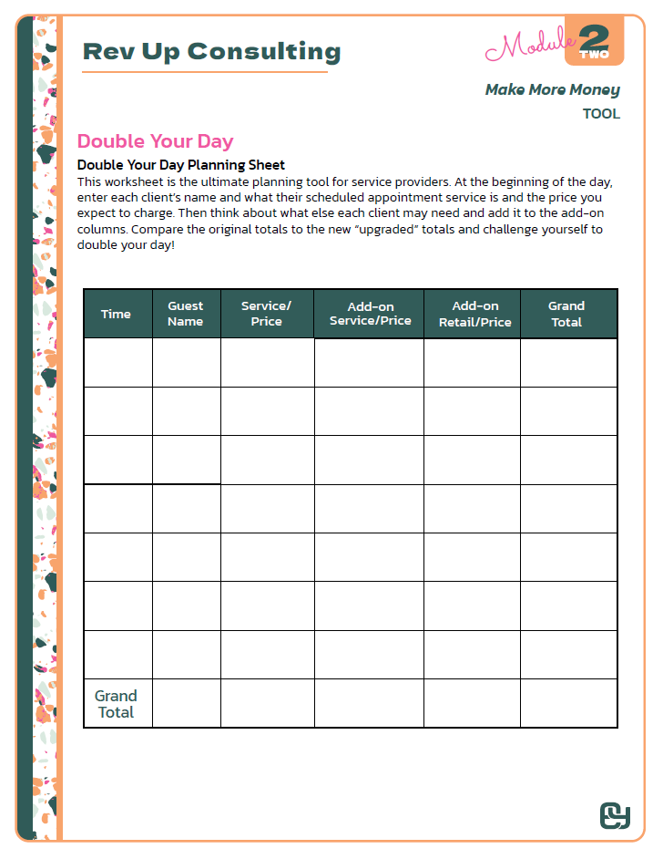
Double Your
Day Tool
Don’t be order-takers
Come in 15 min early to double your paycheck
I had a client make over $30k more this year by doing this one thing!

Slide 41
By discovering what each client is interested in, you can add value to their lives that goes beyond just business.

Slide 42
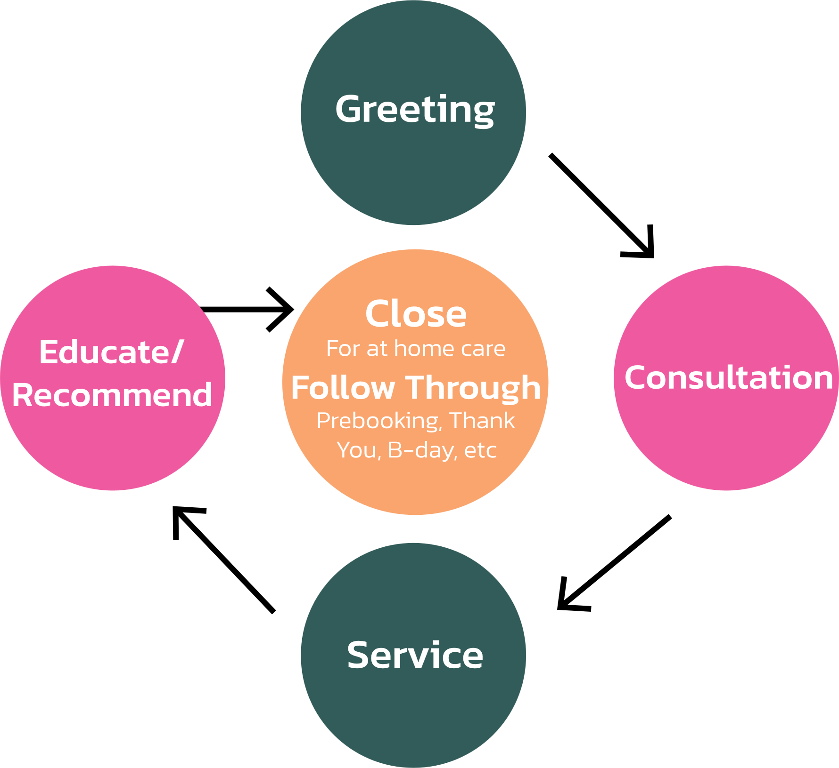
#3 Systems For Success Is Your Job!!
Notes:
Tool- consultation CD and worksheet

Slide 43
Clients Want Two Things!
Solutions to their problems
To feel good
Are we listening to our guests’ needs and offering solutions to fulfill them?

Slide 44
Create The Culture Of Service
Uncovering Your Guests’ Needs:
When was the last time your was perfect?
What made it perfect that time?
What challenges/problems are you currently having?
If you could change anything about your what would it be?
What product are you currently using for home care?
Notes:
West Glam: by taking on the consultation Mary increased her income over $755 weekly

Slide 45
Create The Culture Of Service
Recap:
What I heard you say…(repeat what you heard your client say)
Ask: Would you like my recommendations based on what I am hearing from you today?
What I recommended is
Ask: What would you like to get started with today?
Notes:
West Glam: by taking on the consultation Mary increased her income over $755 weekly

Slide 46
Which Money Tool Will You Pick?
Budgets
Double Your Day
Consultations
Notes:
Sing I love money--- lots and lots of money

Slide 47
Let’s Recap
Take time to grow your cash confidence
How to tap into each area of your current and future business for profits
Be committed to the paycheck of your dreams
Work on launching the instant income tools to profits
Be resilient and consistent
Grow you!

